Slide 1
MessageVortex
Unlinkable, censorship-resistant communication
Notes:
The following slide set is a short intro in MV
A system suitable for anonymous communication even in censored environments.

Slide 2

MessageVortex
Unlinkable, censorship-resistant communication
Notes:
The following slide set is a short intro in MV
A system suitable for anonymous communication even in censored environments.

Slide 3
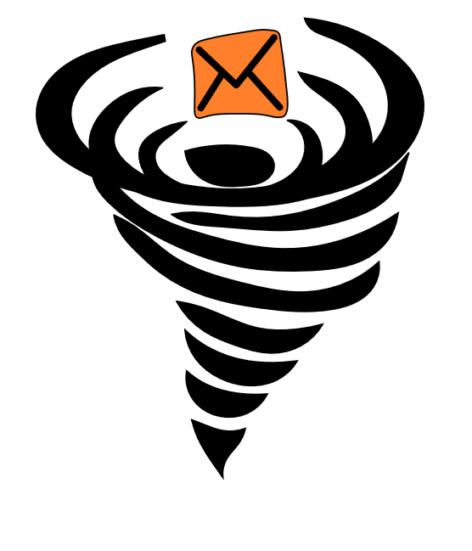
Table of Content
Why do we need it?
Existing systems and their problems
MessageVortex
Design principles
Inner Workings
Message Components
Operations
Analysis
Notes:
First we look at the question “why (and where) is anonymity important”
We then look at the predecessor systems and identify main problems of them
We then dive into the MessageVortex system and explain how we achieve anonymity and why our approach is better.
We then analyze our system and reconsider the lists of the downsides of other systems and compare them to MV

Slide 4
MessageVortex Why do we need it?
Everyone shall have the right to hold opinions without interference
Everyone shall have the right to freedom of expression; this right shall include freedom to seek, receive and impart information and ideas of all kinds, regardless of frontiers, either orally, in writing or print, in the form of art, or through any other media of his choice.
Article 19 of the International Covenant on Civil and Political Rights (ICCPR)
In other words: Wherever censorship exists, there is no freedom of speech.
Notes:
The International Convenant on Civil and Political Rights states that “Everyone shall have the right to hold opinions without interference”
This is what we normally refer as freedom of speech.
A typical interference in this context is a censor.
[click]
But: The only way speaking freely, is when we are anonymous towards a possible censor.

Slide 5
MessageVortex Why do we need it?
Censoring (in general and of Anonymity technology) happens today
North Korea (Internet is fully censored and no privacy enhancing technology is allowed)
China (blocks Tor, calculate citizen score)
Iran (Only Government approved VPNs are legal)
Turkey (VPNs banned, Websites censored)
United Arab Emirates (VPN is illegal for illegal activities ;-))
And more … (Bahrain, Ethiopia…)
Censorship is done to…
fight „terrorism.“
fight „state decomposing elements.“
stopping “immoral or anti-religious works.”
Agreement: Censorship exists‘
its use may be questionable
Notes:
So we have to ask ourselfes: Are there any censors? Yes there are officialy censors such as Iran, China or North Korea.
Most of them ban anonymization and sometimes even encryption technologies.
Some examples are listed here and of course none of them is evil. They always do it for the good of the country and its people.

Slide 6
MessageVortex Why do we need it?
Conclusion: Anonymity (in terms of unobservability) matters especially in censored environments.
Achieving anonymity is hard from an academic point
Achieving anonymity in a censored environment is far harder
All identifiable anonymization technologies are censored or observed
We lack systems designed for censoring environments
Some offer extensions which try to address parts of this issue (e.g., Tor and its pluggable transports)
Notes:
So we need a system which is not only suitable for “free” jurisdictions, but for ALL. Even for censoring ones.
However, achieving anonymity is hard but in an environment with an active adversary, even harder.

Slide 7
Pre-Existing Systems
Remailers (0-III)
Nym Remailers
Cypherpunk
Mixmaster
Mixminion
Onion/Garlic Routing (SOR, Tor, I2P, …)
DHT (Salsa, Tarzan, …)
DC-Nets (Herbivore, Dissent, …)
Broadcast (Hordes, …)
Distributed Storages (Freenet, Guntella(2), …)
None of these systems were designed with a censor in mind!
Notes:
If we look at the existing systems they do a pretty good job in anonymizing.
We have many preexisting systems such as “Onion Routing Systems”, DHT-based systems, DC-nets, broadcast based systems, or distributed storages and remailers.
[click]
Unfortunately, none of these systems were designed with a censoring environment in mind. All of them with some limitations, may be identified with simple measures such as the port number or traffic content.

Slide 8


What are the Problems?
Technology
A (network) packet is always visible…
everyone may see it.
everyone may analyze it.
everyone may forward(modified or unmodified) or keep it.
If we distribute data, we need to recover enough parts.
It is relatively easy to build something for the lab but most of the approaches (e.g., broadcast based) do not scale.
Juristic
Every jurisdiction applies their own laws to all traffic passing their infrastructure
Laws may disagree with each other
Notes:
We have two kinds of problems technological problems and jurisdictional problems.
On the technological side one of the main problem is, that a network packet is always visible and might be manipulated. If we distribute data a recipient needs to recover enough parts while a censor must be unable to censor them. And if we build something as an academic system it should work outside the lab.
On the jurisdictional side we have no means of controlling what jurisdiction applies to a packet. And the applicable laws may disagree.

Slide 9
MessageVortex general weak spots of anonymization solutions
Anonymization infrastructure
Identifiable meta data
Identifiable messages
Replayable messages
Bugable parts
Tagable parts
Bootstrapping problem
Identification problem
Huge traffic overhead
Sender
Receiver
aRouter
aRouter
Sender
Receiver
Sender
aRouter
aRouter
Receiver
Sender
Receiver
aRouter
aRouter
Sender
Sender
Receiver
aRouter
Sender
aRouter
Notes:
A typical anonymity system consists of a set of message senders, a set of recipients and a set of anonymity routers doing their magic to anonymize.
Some of them have messages leaking information or allowing tagging or bugging
Almost all of them outcurve a bootstrapping problem using centralized, known infrastructures which allow a censor to centrally attack such a system.
Most of them do not allow that sender and recipient may disclose their identity in a pseudonymous way. That I can discover if two messages were received from the same (unknown) person.
All of them have a significant traffic overhead

Slide 10
MessageVortex general weak spots of anonymization solutions
Anonymization infrastructure
Identifiable sets for senders and receivers
Identifiable infrastructure
Nodes in general
Entry nodes
Exit nodes
Central elements in infrastructure
Directory servers
Not prone to active adversaries
Identifiable (censorable) protocols
(Limited) trust in infrastructure
Sender
Receiver
aRouter
aRouter
Sender
Receiver
Sender
aRouter
aRouter
Receiver
Sender
Receiver
aRouter
aRouter
Sender
Sender
Receiver
aRouter
Sender
aRouter
Notes:
The sender and recipient sets are typically identifiable (due to protocol breaches in entry and exit nodes.
They have identifiable infrastructure and are typically not prone to active adversaries.
Furthermore, they typically put trust in bigger parts of their infrastructure.
[5 Minuten]

Slide 11

How does it work The general idea
Principles
Unobservable from the outside
Distrust everyone (…)
Routing nodes learn as little as possible from routing a message
The routing process is controlled by the builder of the routing block in the message
The routing path is diagnoseable by the builder of the routing block
Our only trust: initial sender of the message and final recipient of the message
Decoy traffic is not even identifiable for the node generating or routing.
Resistant to common attacks which are hard to cover
Idealy: Invisible and untraceable
Notes:
So what do we do different in MV?
We follow some design criteria which counter such weaknesses.
We designed a protocol which should be as invisible as possible from the outside.
We distrust everyone except the sender and the recipient.
Decoy traffic should not be identifiable. This should be even the case for the node generating the decoy traffic.
We keep the known attacks (and not only the anonymity) in mind wen creating our protocol.

Slide 12
How does it work The general idea (1)
MessageVortex mixes message for anonymity, but…
The senders controls all aspects of the message
Any router on the way learns nothing but
from what IP the message did come
to what IP the message did go
He has no clue which part of the packages received, sent or generated are message related and which are not
All messages are hidden within a transport protocol (e.g. SMTP or XMPP)
Notes:
MV is a mixing system but unlike other mixer systems, a MV mixer, or router as we call it, is unaware of what it is doing.
Any modification to parts of the message may be either to add complexity to the real message or simply is a decoy operation.
Message sizes may increase or decrease randomly in message and decoy traffic and are hidden within a normal common transport protocol for chat or email.
[CLICK]
And all this lot is always controlled by the original sender of a message. He always has full control

Slide 13




How does it work The general idea (2)
Messages are sent from node to node in a mix type like system
One VortexNode consists of…
An always connected device of an end-users
One or more common Transport accounts (e.g., Gmail account)
Mixer Applies operations controlled by the routing block builder (RBB)
Outer Messages of the system
Have machine generated content (e.g., password recovery request)
Include at least one image
VortexMessage is steganographically hidden within the Image
Notes:
And how do we send messages?
We send a message through several VortexNodes. Each node consists of an always connected user owned device such as a mobile phone [CLICK] or a tablet [CLICK] and a transport layer infrastructure (which may be something like a gmail [click] or Yahoo [CLICK] account).
The messages sent by the system look like regular, machine generated messages such as password recovery requests or monitoring messages containing custom imagery. We hide our VortexMessage within these images using steganographic algorithms such as F5.

Slide 14
How does it work The general idea (2; Functioning)
Each node gets a couple of payload blocks
It recombines available payload blocks
Payload block of any message from the same sender (short term pseudonym)
Outcome may be bigger or smaller depending on the applied operation:
Any payload block may be decoy or true message content!
Even the routing node generating decoy cannot tell decoy from message traffic apart.
Agile
Broken (crypto) algorithms must not break the protocol
Network does not depend on a monolithic software version
Any type of algorithm should have an alternative
Notes:
Each receiving node gets with a message a couple of payload blocks and the instructions how to handle them.
The applied operations result in either a bigger, same sized or smaller block.
A node is unaware if the received or sent block (and this is special) is decoy or real message traffic. This applies even if the decoy is generated on the very same system.
And even better: All implemented algorithms have alternatives. A sender may decide on the kind of operations such as encryption and its parameters. If AES is no longer suitable an alternative, such as camelia in this case, has been defined for each algorithm. Nodes are able to signal their capabilities and a sender may freely choose from them.

Slide 15
Interlude Pick any node
Interlude (Demo part1)
The MessageVortex implementation has released source code on github
The demonstrator hosts six MessageVortex nodes as “micro internet”
A controller collects all the logs of the transport layer and visualizes sending and receiving
Task
PLEASE PICK A NODE FROM 2-6
SHALL I SHUT IT DOWN OR SIMPLY DISCONNECT POWER?

Slide 16
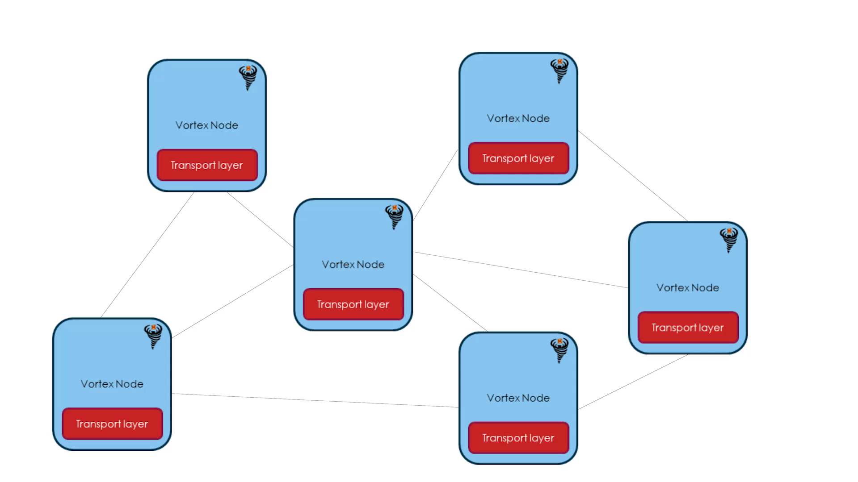
MessageVortex How does it work?
Nodes send and mix messages
All equal
All may be endpoint of a message
All do routing
Hide their traffic in common transport protocols
Messages
Purely controlled by an onionized routing block
Not identifiable unless you possess a node specific key
Always connected end-user device (e.g., mobile phone)
Any Transport layer infrastructure (e.g., Gmail account)
Notes:
So a sender, which is a VortexNode, sends a message through other VortexNodes. Any of the nodes may be the sender or the recipient of a message.
The message properties are controlled by the builder of the routing block which we call “Routing Block Builder” or RBB. This is typically the original sender but may be the recipient in the case of a reply block.
No node may talk to another node unless the public key of the receiving node is known.
In our protocol we refer to a sender of a VortexMessage on the transport layer as sending respectively receiving peer. The original sender of the message is referred as “Sender” and the final recipient as “Recipient”.

Slide 17


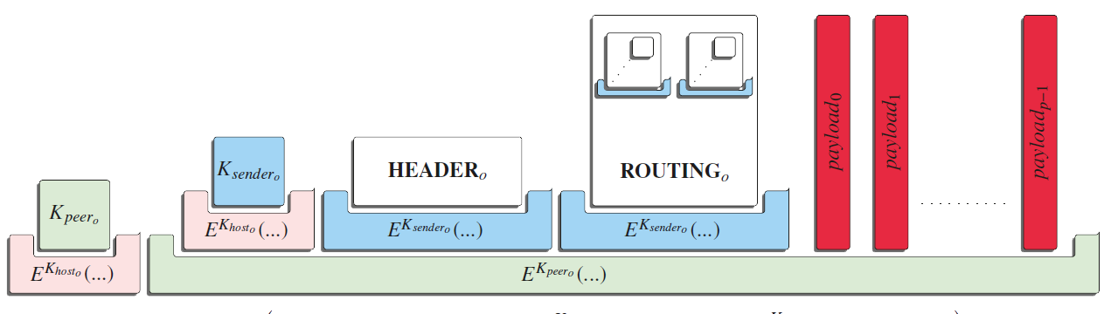
MessageVortex How does a message look like (on the transport layer)?
Dear sir
This is an obviously machine generated text with some images. May be a password recovery request, a routing graph, or any other kind of machine generated information.
Yours
MessageVortex
Generated image. E.g.,
QR-Code
Network graph
Identicon
Gravatar
Random-Avatr
Extract
(e.g., „F5“ or similar steganographic algorithm)
Notes:
So… when a VortexNode receives a message on the transport layer (say a email on my Gmail account)
[click]
the imagery of the email is searched for a steganographically hidden message and extracts an encrypted stream candidate
[click]
The Imagery and the text are machine generated messages such as reports, QR-Codes, Graphs and similar, changing imagery.
[CLICK]
And within these images we hide our messages.

Slide 18
MessageVortex How does a message look like?
Header block „identifying“ the sender and containing requests (short term pseudonym)
Onionized routing blocks containing information on how to route and mix the message
The encrypted peer key
The encrypted sender key
The peer key protects the „inner message“
The sender key protects the vital blocks
One to many message payloads (parts of the message or decoy)
Notes:
The extracted stream has the following building block structure…

Slide 19

MessageVortex The peer key
Important side note: The sending node does not(need to) have the receiving nodes public key
The peer key is encrypted with the receiving nodes public key
The peer key was also included in the message build instructions (in the routing block) of the sending node
The peer key is only known to the two peering partners and the RBB
(sending) VortexNode
(other) VortexNode
Transport layer
Transport layer
VortexNode
(receiving) VortexNode
The RBB is the creator of the routing block
Transport layer
Transport layer
Routing Block Builder (RBB)

Slide 20
MessageVortex The sender key
The sender key is only known to the receiving node and the RBB.
The sender key is encrypted with the receiving nodes‘ public key.
Reminder: The sender key protects the header and the routing block additionally. Otherwise, the sending peer would know its content.
(sending) VortexNode
(other) VortexNode
Transport layer
Transport layer
VortexNode
(receiving) VortexNode
Transport layer
Transport layer
Routing Block Builder (RBB)

Slide 21
MessageVortex The Header
Contains:
An „ephemeral ID“ (eID; public key; synonymous to the sender)
A serial (allows replay protection)
Validity interval
May contain:
Requests (and the reply block)
Proof of work (if requesting something)
Important: All eIDs sign their header blocks with their private key.
Notes:
The header contains an “ephemeral ID” which is a short term pseudonym of the sender and is cryptographically signed,
Furthermore it contains a serial with a validity interval for replay protection and house keeping and may contain header requests or assigned proof of works (which are required to protect from flooding attacks).

Slide 22
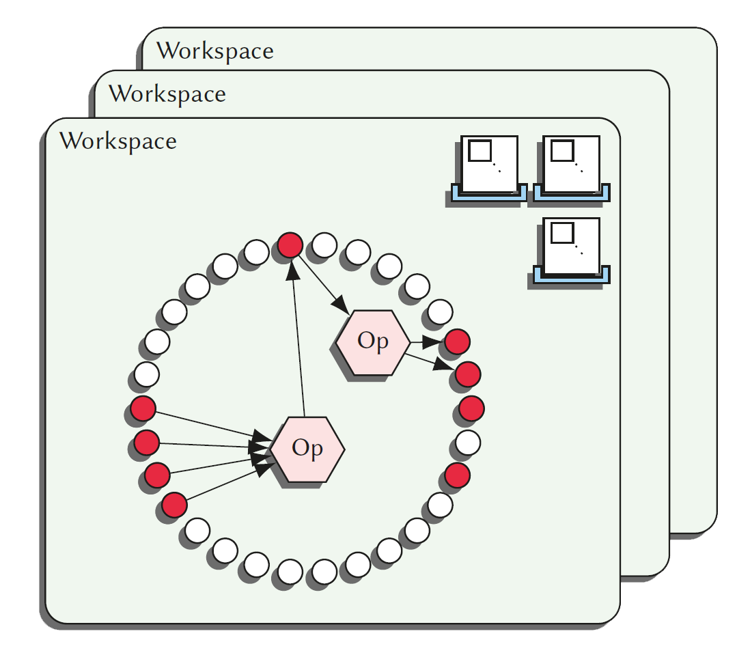
MessageVortex What is an eID? What is a workspace?
An eID is a short term synonym for the sender.
A sender must request eIDs on each node (with a request) before sending messages with a payload.
A sender may require solving a crypto puzzle to get an eID.
An eID enables a sender to have a temporary, exclusively assigned storage on the node called „workspace“.
Each eID has a quota assigned.
The maximum number of inbound messages with a payload.
The maximum number of outbound bytes of messages with a payload.
A workspace is…
For one eID
Contains
Payload blocks (referenced by IDs)
Routing blocks/combos
Operations
Notes:
The eID is an asymmetric key. It has first to be allocated by the sender.
The eID maps to a custom storage for this ephemeral identity for routing payloads.
Furthermore it has quotas assigned limiting the number of incoming messages with payload blocks as well as the number of outgoing bytes.
The workspace contains the payload blocks received for this eID, the routing blocks to be processed and the operations required to assemble subsequent payload blocks.

Slide 23
MessageVortex The Routing Block
The routing block contains
Handling instructions for the current node Operations required for local handling which includes mapping of IDs from the message into the workspace.
Onionized routing information required for building subsequent messages (Routing combos). They contain:
The pre-encrypted peer key for the next peer
The pre-encrypted header key for the next peer
The pre-encrypted header
The pre-Encrypted routing block
Mappings for workspace IDs into the message
The blending information for the generated message
Transport address
Blending methode (e.g., F5 with key “test123”)
Notes:
The routing block contains:
The operations required for handling the incoming payload blocks.
And routing combos containing all the pre-encrypted blocks required for the subsequent message as well as the instructions on how to compose them. Furthermore the routing combo contains the blending instructions as well as the transport layer address for the subsequent nodes.

Slide 24
MessageVortex available operations
Each operation is defined by input Ids and output Ids.
We have three types of operations (always a tuple):
Split/Merge a payload
Encrypt/Decrypt a payload
addRedundancy and removeRedundancy
Pay
Payload
S
load
M
Payload
Payload
E
„&+/WSGJ
D
Payload
Payload
R
M e a u P o
R⁻¹
Payload
o n s a a
r t t y d
e r h j l
This is where the magic happens
Notes:
The operations themselves are simple.
We have an operation to split and merge a payload block.
We have an operation to encrypt and decrypt a payload block and we have a operation to add or remove redundancy information.
[CLICK]
This is actually where the magic happens.
There is actually a fourth operation called mapping available which simply maps one ID to another for operational reasons.

Slide 25
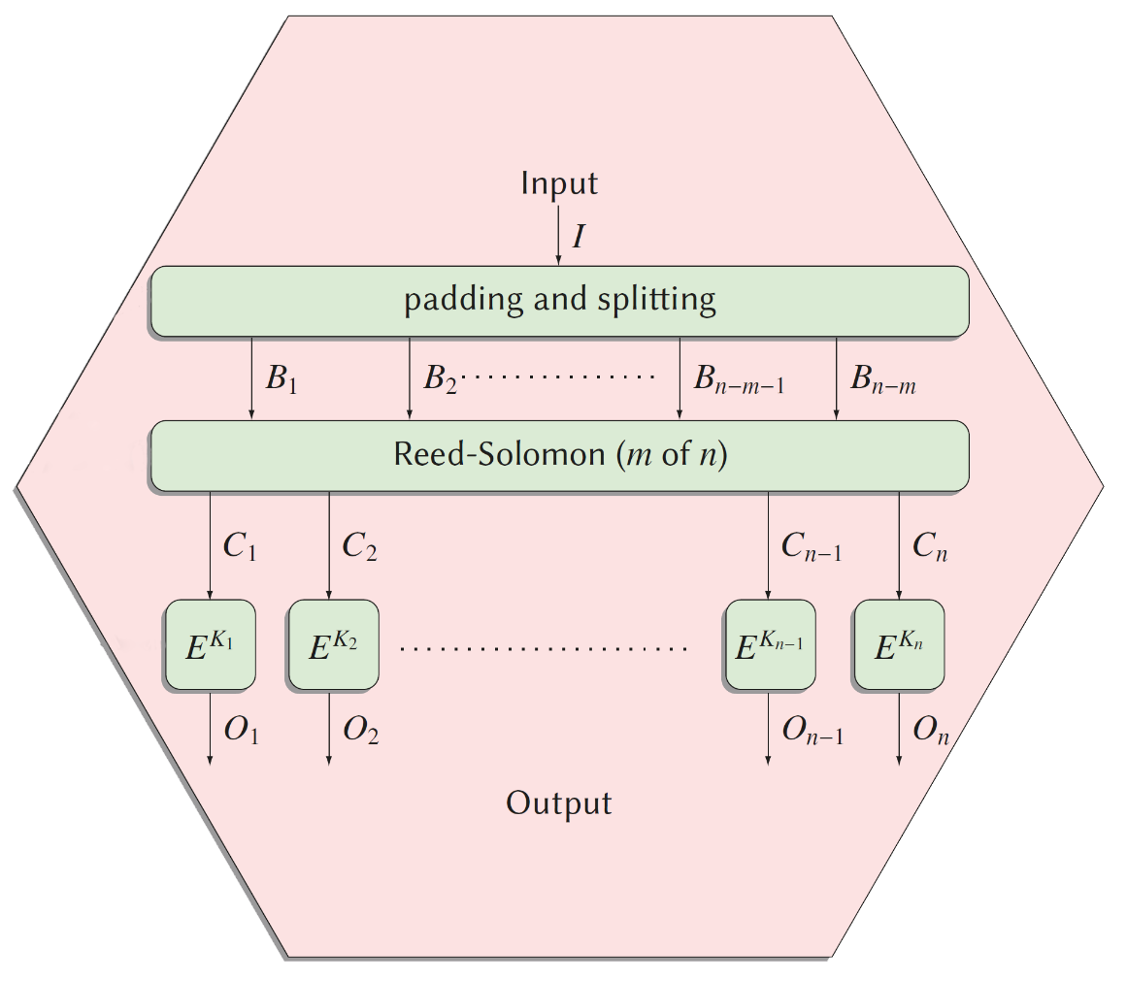
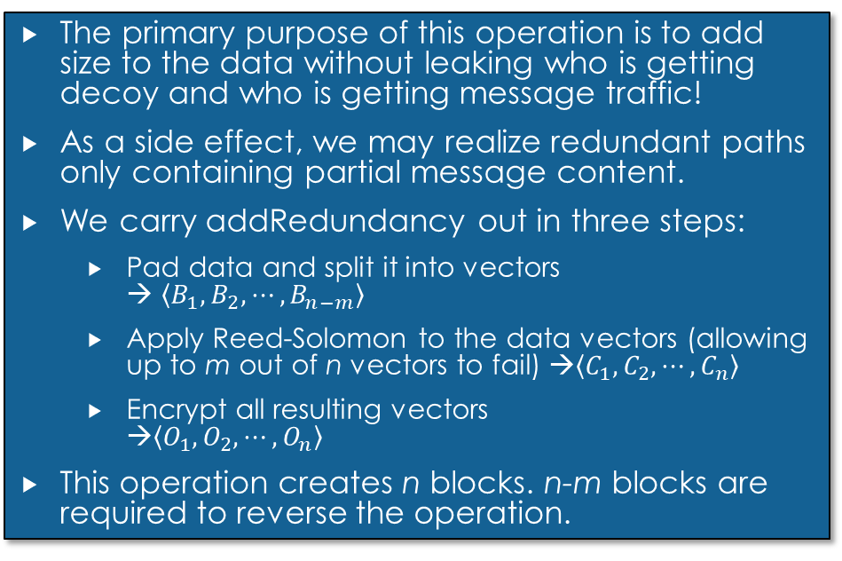
MessageVortex The addRedundancy operation (1)
The primary purpose of this operation is to add size to the data without leaking who is getting decoy and who is getting message traffic!
As a side effect, we may realize redundant paths only containing partial message content.
We carry addRedundancy out in three steps:
Pad data and split it into vectors → $\left\langle B_{1}, B_{2}, ⋯, B_{n−m}\right\rangle$
Apply Reed-Solomon to the data vectors (allowing up to m out of n vectors to fail) →$\left\langle C_{1}, C_{2}, ⋯, C_{n}\right\rangle$
Encrypt all resulting vectors →$\left\langle O_{1}, O_{2}, ⋯, O_{n}\right\rangle$
This operation creates n blocks. n-m blocks are required to reverse the operation.
Simplification: The same operation we would do with stripes in a RAID6 disk array with a specialized padding
Notes:
The redundancy operation forms the core of our system and is thus described here closer. It consists of three steps:
Padding, adding the redundancy information, and encrypting the resulting blocks.
At the end we have n blocks where as any n-m blocks are sufficient to recover the transferred information.
To make sure that we do not leak sizing information through the padding we apply a specialized padding.

Slide 26
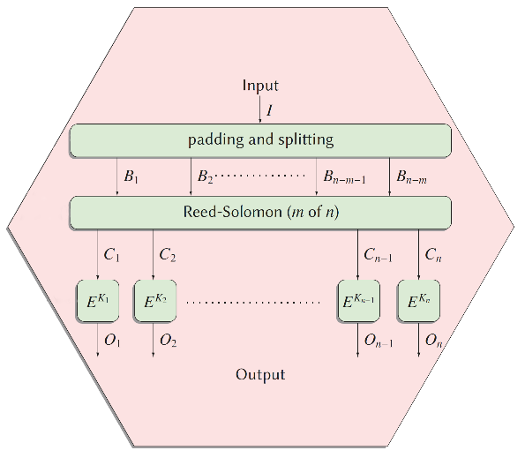

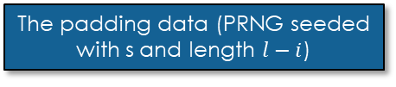
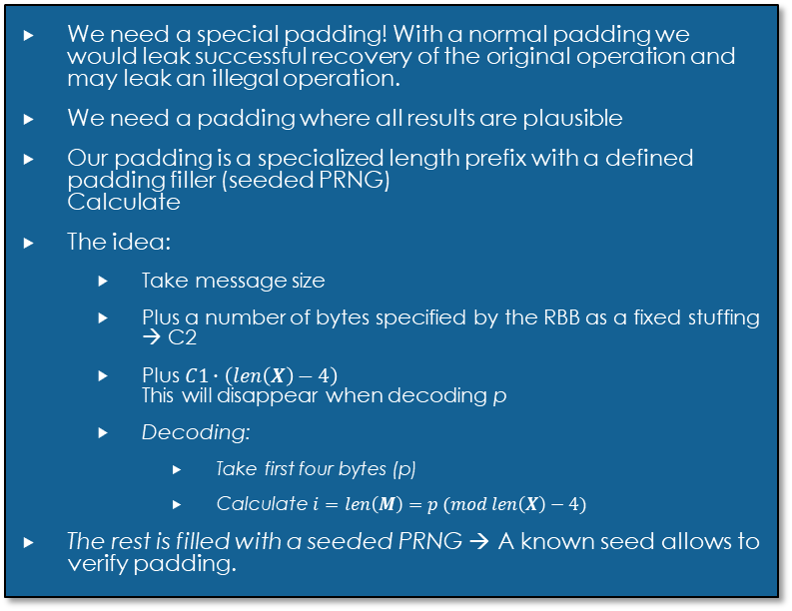
MessageVortex The addRedundancy operation (2)
We need a special padding! With a normal padding we would leak successful recovery of the original operation and may leak an illegal operation.
We need a padding where all results are plausible
Our padding is a specialized length prefix with a defined padding filler (seeded PRNG) Calculate
The idea:
Take message size
Plus a number of bytes specified by the RBB as a fixed stuffing → C2
Plus $C1∙\left(len\left(X\right)−4\right)$ This will disappear when decoding p
Decoding:
Take first four bytes (p)
Calculate $i=len\left(M\right)=p (mod len\left(X\right)−4)$
The rest is filled with a seeded PRNG → A known seed allows to verify padding.
$$i=len\left(M\right)$$
$$e=lcm(blocksize\left(E^{K}\right),n)$$
$$l= \left\lceil \frac{i+4+C2}{e}\right\rceil ∙e$$
$$p=i+ \left(C1∙l \left(mod \left\lfloor \frac{2^{32}−1−i}{l}\right\rfloor ∙l\right)\right)$$
$$X= \left\langle p,M, R\left(s,l−i\right)\right\rangle$$
The padded message
The padding value (length; 4 Bytes uint)
The padding data (PRNG seeded with s and length $l−i$)
The message
Notes:
The general idea behind the padding is that any padding value p for a message is valid. We calculate the length of the original message by calculating p mod the size of the resulting block on the recipient side.
The value p is calculated by using the length of the message to be padded plus a random stuffing (which reflect additional bytes) in the message plus a random number of block sizes (which will fall off with the modulo operation.
(click)
The message itself is built by
(click) concatenating p as an four byte unsigned integer
(click) with the message to be padded
(click) and a stream of values from a seeded random number generator.

Slide 27
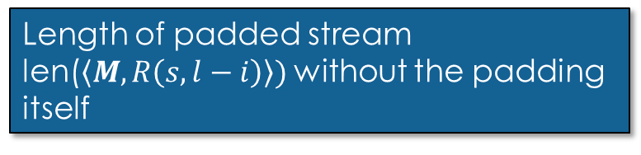

MessageVortex The addRedundancy operation (3)
The length of the original message
$$i=len\left(M\right)$$
$e=lcm(blocksize\left(E^{K}\right),n$)
$$l= \left\lceil \frac{i+4+C2}{e}\right\rceil ∙e$$
$$p=i+ \left(C1∙l \left(mod \left\lfloor \frac{2^{32}−1−i}{l}\right\rfloor ∙l\right)\right)$$
$$X = \left\langle p,M, R\left(s,l−i\right)\right\rangle$$
$=\left\langle p,M, R\left(s,l−(p mod (len(X)−4\right))\right\rangle$
Block size of the operation (dependent on the number of stripes and the cipher block size)
Length of padded stream len($\left\langle M, R\left(s,l−i\right)\right\rangle )$ without the padding itself
Notes:
The calculation is done by
(click) taking the length of the unpadded message
(click) then calculating the minimum block size of the final message
(click) then calculating the padded size of the message accommodating at least the message and the stuffing

Slide 28
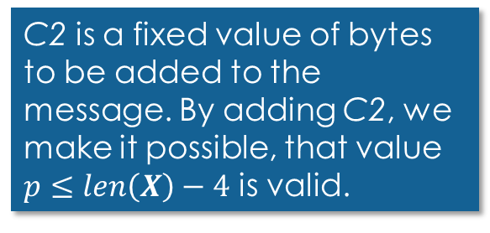
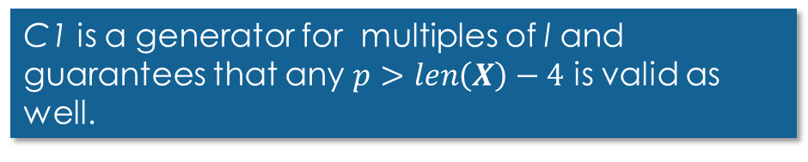

MessageVortex The addRedundancy operation (3)
C2 is a fixed value of bytes to be added to the message. By adding C2, we make it possible, that value $p≤len\left(X\right)−4$ is valid.
$$i=len\left(M\right) \\ e=lcm(blocksize\left(E^{K}\right),n) \\ l= \left\lceil \frac{i+C2}{e}\right\rceil ∙e \\ p=i+ \left(C1∙l \left(mod \left\lfloor \frac{2^{32}−1−i}{l}\right\rfloor ∙l\right)\right) \\ X= \left\langle p,M, R\left(s,l−i\right)\right\rangle \\ =\left\langle p,M, R\left(s,l−(p mod (len(X)−4)\right)\right\rangle$$
C1 is a generator for multiples of l and guarantees that any $p>len\left(X\right)−4$ is valid as well.
We do NOT require the values for successful decoding.
Notes:
We have some randomly chosen values by the RBB which are
(click) C2 representing the size of the stuffing. This is required so that we are unable to determine a possible length of the message when knowing the blocksize of the encryption and the number of resulting blocks.
(click) and C1 representing the number of len(X)-4 falling away with the modulo operation.

Slide 29
MessageVortex The addRedundancy operation (4)
Up until now we have padded the message with the following properties:
The message has a perfect length to allow:
Apply the Read-Solomon operation without further padding
Apply the encryption without further padding
Any value of p may reflect a valid padding
→ Let‘s apply Reed-Solomon
Interlude: Reed Solomon (RS) is a code used typically for error correction.
It adds a constant but selectable error correction information to the data, allowing m out of n data chunks to fail.
In the real world, RS is typically used in a stripped manner in RAID6 systems to allow multiple disks to fail without losing data.
Notes:
We have now padded the message in a way the we do no longer require padding in the subsequent operations.
Furthermore the padding des no longer leak successful operation reversal.
(click)
Now we apply the Reed-Solomon operation. As an interlude. Nowadays we use this operation heavily in RAID6 systems to add scalable redundancy,

Slide 30
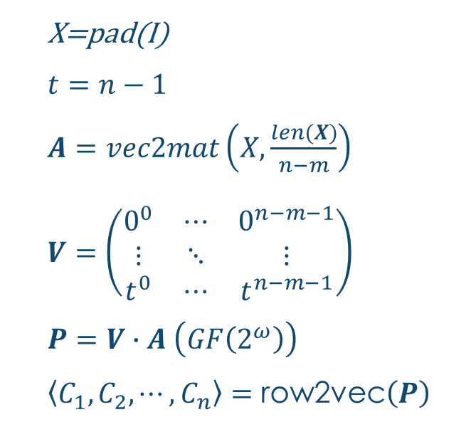
MessageVortex The addRedundancy operation (2)
X=pad(I)
$t=n−1$
$A=vec2mat\left(X,\frac{len(X)}{n−m}\right)$
$V=\left(\begin{matrix}0^{0} & ⋯ & 0^{n−m−1} \\ ⋮ & ⋱ & ⋮ \\ t^{0} & ⋯ & t^{n−m−1}\end{matrix}\right)$
$P=V∙A \left(GF\left(2^{ω}\right)\right)$
$\left\langle C_{1}, C_{2}, ⋯, C_{n}\right\rangle =\text{row}\text{2}\text{ve}\text{c}\left(P\right)$
We allign the padded data in a matrix
We prepare a suitable Vandermonde matrix (m rows and n colums)
We apply RS The result is a matrix with the message and added redundancy information.
We extract the rows as vector
Notes:
(click)
First we align the padded data stream as a matrix with n-m rows
(click)
We then create a dispersal matrix by creating a vandermonde matrix. Actually, any matrix would do as long as a matrices resulting in deleting sufficient rows to form a square matrix are invertible.
(click)
we then multiply the two matrices over a finite field
(click)
And extract the rows of the resulting matrix as payload blocks

Slide 31
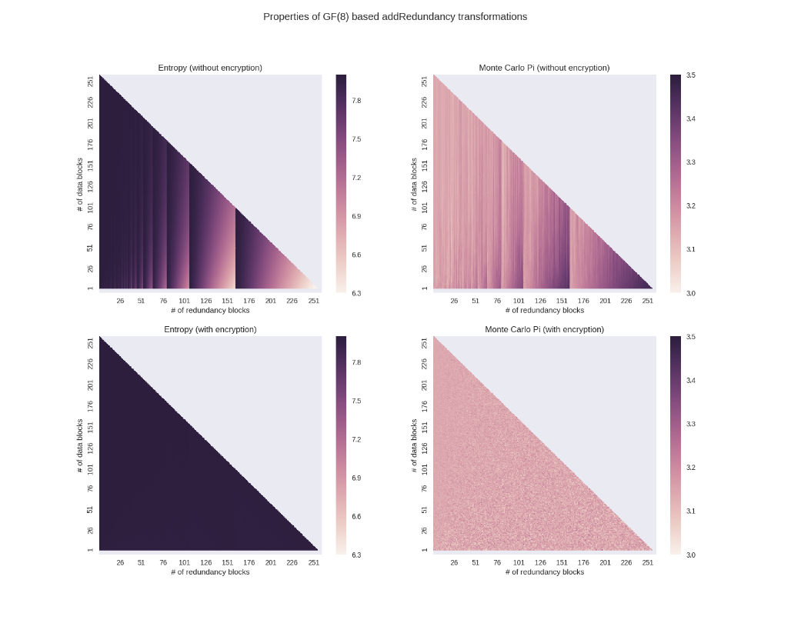
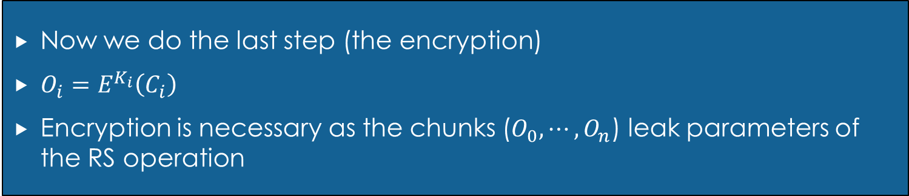
MessageVortex The addRedundancy operation (3)
Now we do the last step (the encryption)
$O_{i}=E^{K_{i}}\left(C_{i}\right)$
Encryption is necessary as the chunks ($O_{0},⋯, O_{n}$) leak parameters of the RS operation
Entropy and Monte Carlo PI WITHOUT encryption with varying parameters on the same.
Entropy and Monte Carlo PI WITH encryption with varying parameters on the same block.
Notes:
The only thing left is the encryption step.
This step is required as the reed Solomon operation leakes its parameters. This is shown in the graph.
(click) When not encrypted we clearly see an identifiale pattern when looking at the entropy.
(click) after the encryption step this pattern is gone again.

Slide 32

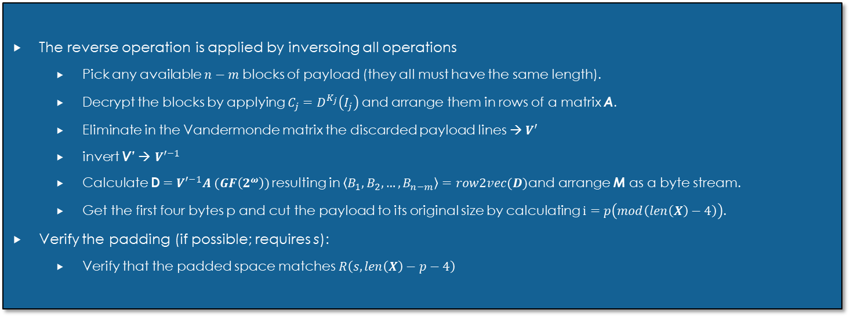
MessageVortex The addRedundancy operation (4)
$$X= \left\langle p,M, R\left(s,p mod (len(X)−4\right)\right\rangle$$
The reverse operation is applied by inversoing all operations
Pick any available $n−m$ blocks of payload (they all must have the same length).
Decrypt the blocks by applying $C_{j}=D^{K_{j}}\left(I_{j}\right)$ and arrange them in rows of a matrix A.
Eliminate in the Vandermonde matrix the discarded payload lines → $V′$
invert V’ → ${V′}^{−1}$
Calculate D$={V′}^{−1}A (GF\left(2^{ω}\right))$ resulting in $\left\langle B_{1}, B_{2}, …, B_{n−m}\right\rangle =row2vec(D)$and arrange M as a byte stream.
Get the first four bytes p and cut the payload to its original size by calculating $i=p\left(mod\left(len\left(X\right)−4\right)\right)$.
Verify the padding (if possible; requires s):
Verify that the padded space matches $R\left(s,len\left(X\right)−p−4\right)$
Notes:
The reverse operation is just the inverse steps in the opposite order.
First pick any n-m blocks.
Decrypt the blocks with the key provided. And align as a matrix again.
Create the same dispersal matrix, eliminate the non-chosen block-rows and invert it
Multiply the two matrices over a finite field.
Calculate the message length by taking p mod len(X)-4.
Optionally you may verify the padding by seeding the specified PRNG and comparing the trailing bytes.

Slide 33
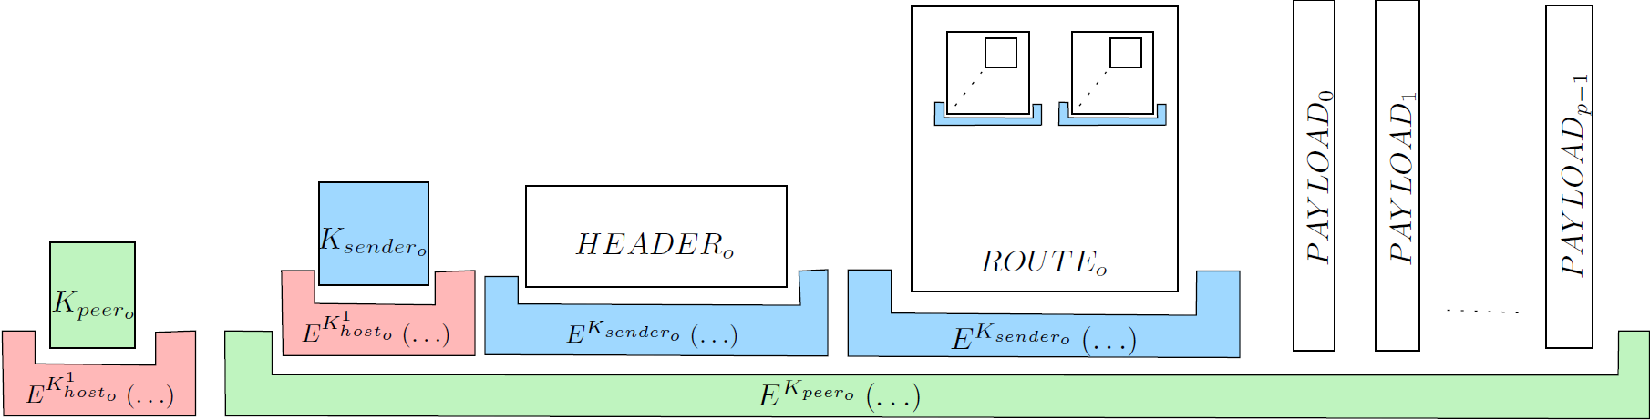
MessageVortex Processing an incoming message
Dear sir
This is an obviously machine generated text with some images. May be a password recovery request, a routing graph, or any other kind of machine generated information.
Yours
MessageVortex
Extract message by the blending layer
Extract message prefix block and decrypt it.
If a valid structure with a peer key is provided continue with the inner message by decrypting with the key provided in the prefix block.
Get sender key and decrypt header, and routing block
Verify signature of header and rules for processing
Process header requests (if applicable)
Apply mapping operations for IDs 1 up to 127 into workspace (mapping of payload blocks into the workspace)
Add operations to the workspace
Add routing combos to the workspace
If a message is written to payload ID 0 then this message is for the local user
Notes:
So lets look at the processing of an incoming message in detail.
A transport layer message is received and the vortexMessage is extracted
(click)

Slide 34
MessageVortex Processing an incoming message
Extract message by the blending layer
Extract message prefix block and decrypt it.
If a valid structure with a peer key is provided continue with the inner message by decrypting with the key provided in the prefix block.
Get sender key and decrypt header, and routing block
Verify signature of header and rules for processing
Process header requests (if applicable)
Apply mapping operations for IDs 1 up to 127 into workspace (mapping of payload blocks into the workspace)
Add operations to the workspace
If a message is written to payload ID 0 then this message is for the local user
Add routing combos to the workspace
If a message is written to payload ID 0 then this message is for the local user
Notes:
We decrypt the peer key using our host key and decrypt the inner message.
(click)

Slide 35
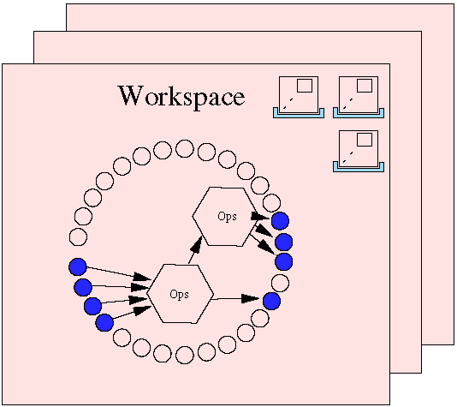
MessageVortex Processing an incoming message
Extract message by the blending layer
Extract message prefix block and decrypt it.
If a valid structure with a peer key is provided continue with the inner message by decrypting with the key provided in the prefix block.
Get sender key and decrypt header, and routing block
Verify signature of header and rules for processing
Process header requests (if applicable)
Apply mapping operations for IDs 1 up to 127 into workspace (mapping of payload blocks into the workspace)
Add operations to the workspace
If a message is written to payload ID 0 then this message is for the local user
Add routing combos to the workspace
Notes:
We extract the sender key using again our host key and extract header and routing block.

Slide 36
MessageVortex Processing an incoming message
Extract message by the blending layer
Extract message prefix block and decrypt it.
If a valid structure with a peer key is provided continue with the inner message by decrypting with the key provided in the prefix block.
Get sender key and decrypt header, and routing block
Verify signature of header and rules for processing
Process header requests (if applicable)
Apply mapping operations for IDs 1 up to 127 into workspace (mapping of payload blocks into the workspace)
Add operations to the workspace
If a message is written to payload ID 0 then this message is for the local user
Add routing combos to the workspace
Verify state of eID
Extract Serial and do replay checks
Notes:
We verify the signature, the state of the ephemeral id and apply the replay checks. Furthermore, we need to check the incoming message quota.

Slide 37
MessageVortex Processing an incoming message
Extract message by the blending layer
Extract message prefix block and decrypt it.
If a valid structure with a peer key is provided continue with the inner message by decrypting with the key provided in the prefix block.
Get sender key and decrypt header, and routing block
Verify signature of header and rules for processing
Process header requests (if applicable)
Apply mapping operations for IDs 1 up to 127 into workspace (mapping of payload blocks into the workspace)
Add operations to the workspace
If a message is written to payload ID 0 then this message is for the local user
Add routing combos to the workspace
Process header requests:
Create new eID
Get node capabilities
Get quotas
Increase quotas
Request routing nodes
Replace identity
PoW or anonymous payment may apply
Notes:
We process the requests if there are any.
Possible requests are:
Create an eID, query the nodes supported algorithms and constraints, query or increase the quotas, request more routing nodes or replace an existing identity.
For some of the requests a proof of work is requested if not required.

Slide 38
MessageVortex Processing an incoming message
Extract message by the blending layer
Extract message prefix block and decrypt it.
If a valid structure with a peer key is provided continue with the inner message by decrypting with the key provided in the prefix block.
Get sender key and decrypt header, and routing block
Verify signature of header and rules for processing
Process header requests (if applicable)
Apply mapping operations for IDs 1 up to 127 into workspace (mapping of payload blocks into the workspace)
Add operations to the workspace
If a message is written to payload ID 0 then this message is for the local user
Add routing combos to the workspace
Notes:
We then map the payloads into our workspace

Slide 39
MessageVortex Processing an incoming message
Extract message by the blending layer
Extract message prefix block and decrypt it.
If a valid structure with a peer key is provided continue with the inner message by decrypting with the key provided in the prefix block.
Get sender key and decrypt header, and routing block
Verify signature of header and rules for processing
Process header requests (if applicable)
Apply mapping operations for IDs 1 up to 127 into workspace (mapping of payload blocks into the workspace)
Add operations to the workspace
If a message is written to payload ID 0 then this message is for the local user
Add routing combos to the workspace
Notes:
Next we do the same with the operations provided

Slide 40
MessageVortex Processing an incoming message
Extract message by the blending layer
Extract message prefix block and decrypt it.
If a valid structure with a peer key is provided continue with the inner message by decrypting with the key provided in the prefix block.
Get sender key and decrypt header, and routing block
Verify signature of header and rules for processing
Process header requests (if applicable)
Apply mapping operations for IDs 1 up to 127 into workspace (mapping of payload blocks into the workspace)
Add operations to the workspace
If a message is written to payload ID 0 then this message is for the local user
Add routing combos to the workspace
Notes:
Lastly we put the routing combos into the respective workspace.
These combos trigger the generation of a subsequent message and contain all the information required t assemble them.

Slide 41
MessageVortex Routing Strategies (general)
Use addRedundancy to add decoy
Use either encrypt or decrypt to (de)onionize
Use Split and merge to join/distribute traffic (requires onionizing or addRedundancy step)
Avoid repeating patterns!
Notes:
How do we assemble a routing block and chose the routing?
In general we use addRedundancy to add decoy traffic and use encrypt/decrypt to onionize the message. To vary the size and join respectively disjoin traffic, we may use split and merge, or addRedundancy.

Slide 42
MessageVortex A simple Strategy for building a routing block
Choose VortexNodes and allocate eIDs if required
Choose a directed suitable graph (Nodes=VortexNodes; Edges=Messages).
Select timing information for the blocks.
Select path(s) for message transferal to final recipient.
Select operations
For the message
For the decoy traffic
Assemble routing block (it is always one at the beginning).
Apply routing block to message and hand it over to the router (local)
The algorithm does not matter! Just follow the rule:
All operations are valid for a data stream
No pattern is repeated on any node except for the sender and the recipient
Notes:
A general strategy may look like this:
First choose a suitable routing graph where nodes reflect vortexNodes and Edges reflect a message between two nodes.
We serialize the messages by assigning timing information.
Then we select a path to our final node and select suitable operations for that path.
Then we do exactly the same for all non covered paths
With this algorithm we may satisfy all preconditions.
In the next slides we cover a simplified example.

Slide 43
MessageVortex A simple Strategy for building a routing block (A word of caution)
For brevity, the following algorithm has no split/merge operations and all nodes receive at least the entire message. This has some drawbacks:
Huge message overhead
Minimum size of message may be determined and traced
Route diagnosis not covered
But…
It credibly anonymizes sender and recipient.
Notes:
This algorithm was shortened for presentation reasons. It distributes the whole message throughout the selected node.
It has some downsides such as a minimum message size or a huge overhead.

Slide 44
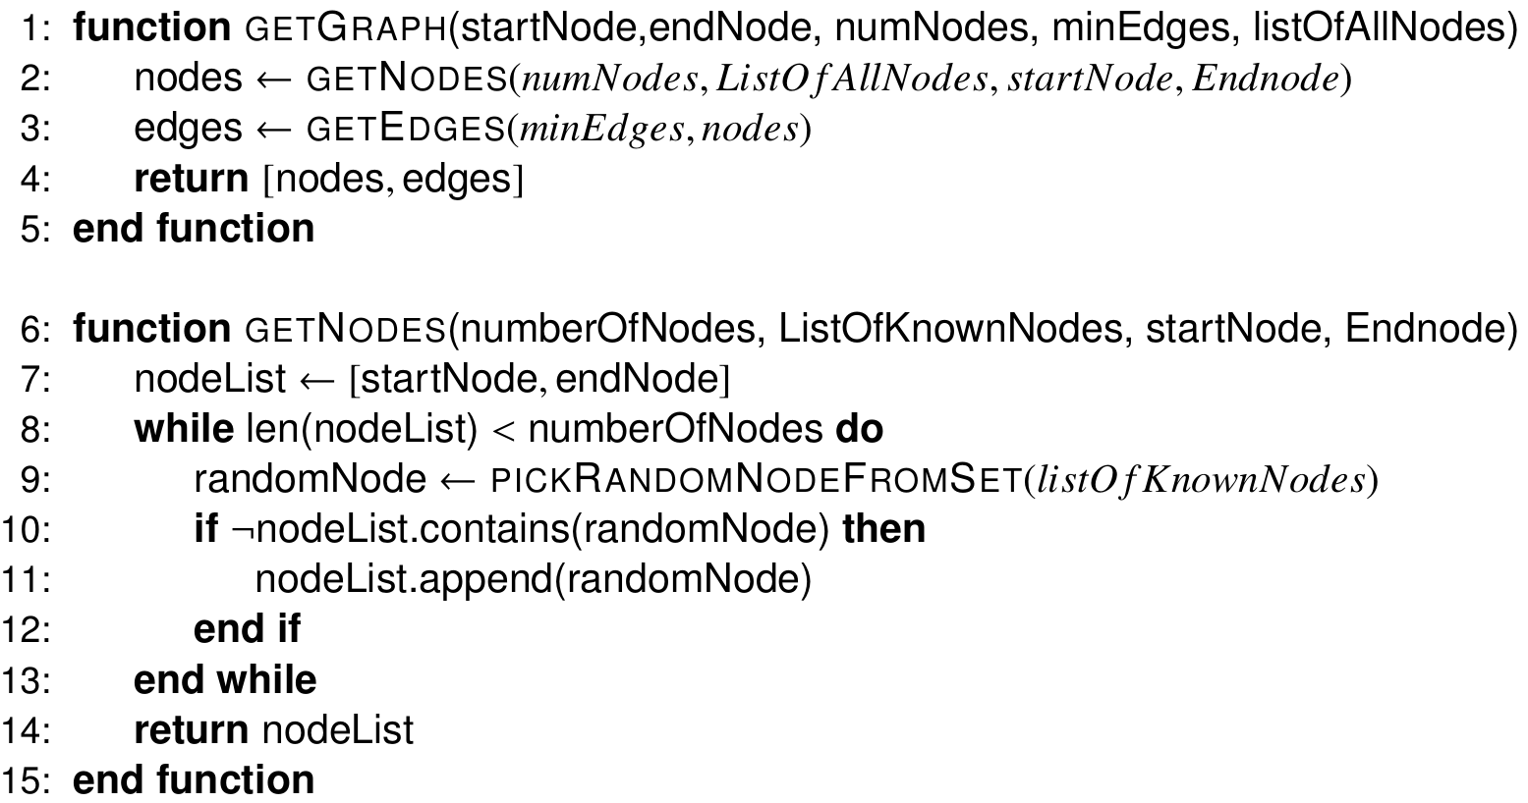
MessageVortex A simple Strategy for building a routing block (The main procedure)
Notes:
First we select randomly the nodes. After that we assign edges.
(click)

Slide 45
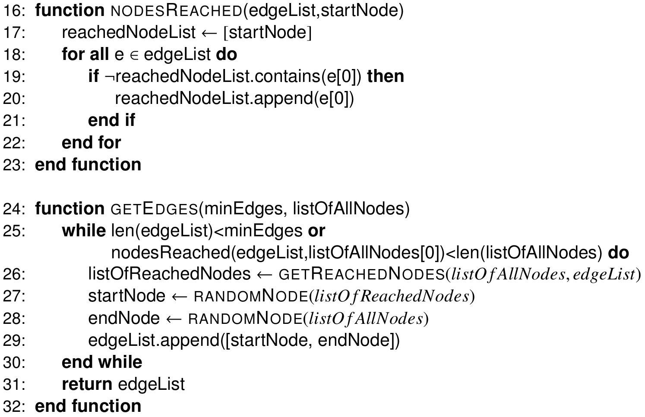
MessageVortex A simple Strategy for building a routing block (The main procedure 2)
Notes:
The edges are chosen by randomly choosing an already reached node and a random node from the whole node set. This step is repeated until we reach the minimum required edges and have reached all nodes of our graph.

Slide 46
MessageVortex A simple Strategy for building a routing block (The main procedure 2)
Notes:
This is a resulting graph with seven nodes and six paths from the sender (which is shown as node 0) to the recipient node 1.

Slide 47
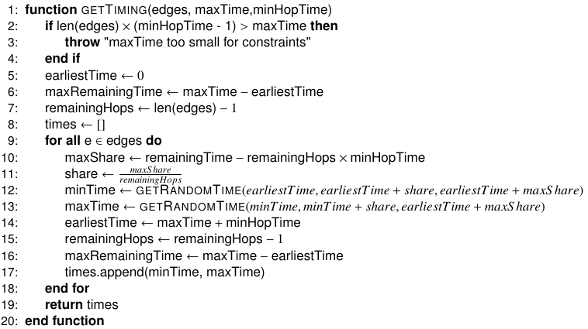
MessageVortex A simple Strategy for building a routing block (Assign Timing)
Notes:
Next, we assign the timing we just loop through all nodes sequentially. And assign a random time increasing from message to message and having a guaranteed time gap between them, This tie gap is reflected by minHopTime.
For convenience, we created a special distribution which we describe in the slide.

Slide 48
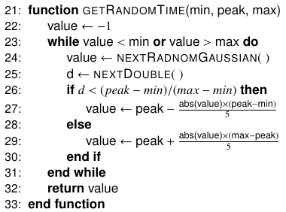
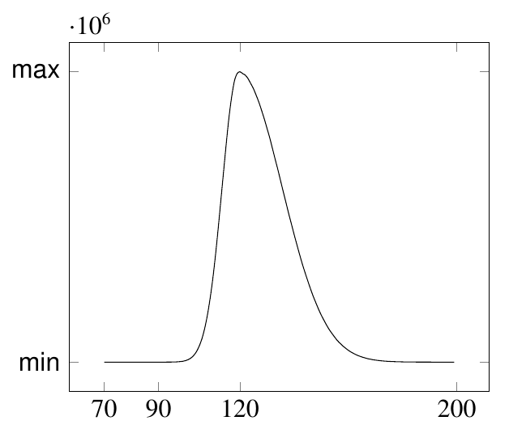
MessageVortex A simple Strategy for building a routing block (Assign Timing)
Notes:
This distribution squishes a gaussian bell curve in such a way that we may specify the optimal location of the maximum and distribute the rest over an interval suitable for us.
We can see the resulting curve of a getRandomTime(70,120,200) in the graph to the right.

Slide 49
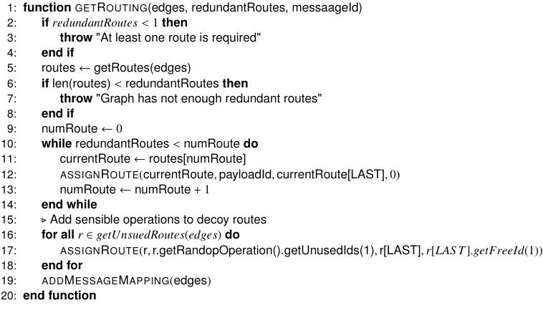
MessageVortex A simple Strategy for building a routing block (Assign Operations)
Notes:
After having assigned the timing we have to select the operations.
We first check if the graph has the right properties as requested.
If so, we take a route from start to the final node and call “assignRoute”
After that we look for chains of nodes which have not yet been reached and repeat the step there.

Slide 50
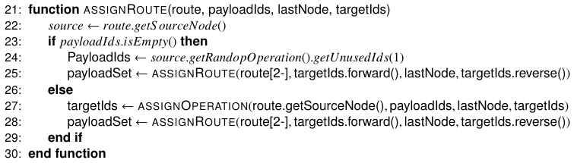
MessageVortex A simple Strategy for building a routing block (Assign Operations)
Notes:
If we have no specific payload to transport we chose a random used payload ID from the current node.
We take the source payload ID and apply a valid operation with assignOperation. The resulting IDs are passed on to the next node and the assignRoute is applied recursively for that node.

Slide 51
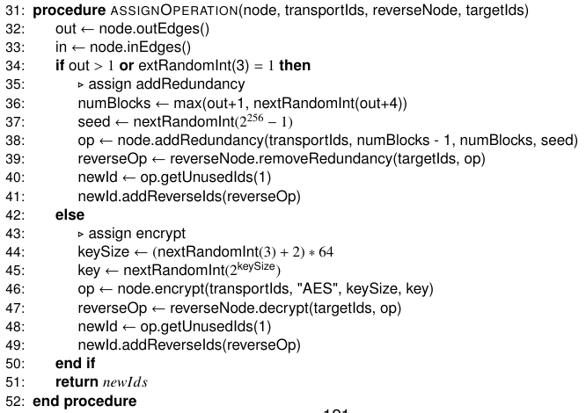
MessageVortex A simple Strategy for building a routing block (Assign Operations)
Notes:
Our Assign operation is relatively simple if we have to route to multiple nodes, we make sure that we do an addRedundancy operation resulting in sufficient blocks. Any block is sufficient to recover the information. If there is only one subsequent node, we choose either an encryption step or an addRedundancy operation.
In any case the respective reverse operation is applied to the final recipient node.
This is a very simple algorithm to assemble a routing block.
But how do we obtain the nodes at the beginning for our routing block?

Slide 52
MessageVortex Where do I get my peer partners from?
In a censoring environment
You need to collect them yourself (manually)
You may route messages outside of the censors reach. Once outside traditional mixing nodes may be used
In a non censoring environment (where usage of MessageVortex is no problem)
Query the nodes directly with a capability request (HeaderRequestCapability)
Ask a node to recover public routing nodes (HeaderRequestNodes)
Notes:
In a censoring environment: Only by knowing people. We were unable to find a solution which would not allow an adversary to harvest nodes.
In a non-censoring environment we have an “request node” header request which allows us to do so.

Slide 53
MessageVortex Where do I get my peer partners from?
In a censoring environment
You need to collect them yourself (manually)
You may route messages outside of the censors reach. Once outside traditional mixing nodes may be used
In a non censoring environment (where usage of MessageVortex is no problem)
Query the nodes directly with a capability request (HeaderRequestCapability)
Ask a node to recover public routing nodes (HeaderRequestNodes)
Notes:
In a censoring environment: Only by knowing people. We were unable to find a solution which would not allow an adversary to harvest nodes.
In a non-censoring environment we have an “request node” header request which allows us to do so.

Slide 54
MessageVortex Analysis
First Quick overview
The first holistic approach targeting the needs of a partially/fully censoring environment
Bases on proven technology
Reed-Solomon operations are proven and well known
Mixing (and its limitations) are well known
Is Cryptoagile
Allows diagnosis
Allows localized trust
Gives full control of all privacy related parameters to the builder of the routing block.
Contributes
A new padding type not leaking any information about successful decryption.
An addRedundancy operation allowing to add redundancy and or decoy traffic without letting the routing node the type of routed data know.
A working system with a reference implementation
Notes:
How do we benefit from MessageVortex?
It is to our knowledge the first holistic attempt to create an anonymizing infrastructure in a censoring environment.
It uses proven technologies and has unique properties such as unidentifiable decoy traffic.
It is cryptoagile and allows diagnosis of routing paths without putting trust in routing nodes or disclosing diagnostic
It gives full control over all privacy aspects to the routing block builder.
And it contributes a specialized padding not leaking successful operation reversal
An novel addRedundancy operation
And a system implementation

Slide 55
MessageVortex Analysis (2)
The outer message is secure as long as…
The steganographic algorithm is not detectable
The message does not follow an identifiable pattern (customizing!)
Only text patterns that exist commonly in the outer realm (outside MessageVortex)
Or text and graphic patterns that are unique to the platform itself (this is a big weakness)
If the stegnographic key and algorithm is known the service remains save as the message has no outer structure.
Notes:
The outer message is secure as long as our steganographic embedding is not identifiable and the message does not follow any identifiable patterns.
Identifiable pattern may include:
Text patterns
Known graphic patterns
Even if a steganographic algorithm and a possibly associated key is known or suspected, the message remains undetectable as it has no structure from the outside and looks as white noise.

Slide 56
MessageVortex Analysis (3)
To address issues of changing the transport level provider redirection messages with signed content help to maintain the social network cryptographically secured.
To address issues enabling a censor to identify nodes when updating, the update channel was realized with VortexMessages.
Notes:
We have furthermore addressed the issue of changing transport layer addresses, as they are out of our control. A message allows at least to known endpoints to be redirected if a transport endpoint is changed. This operation is cryptographically secured to eliminate the possibility of identity hijacking.
Update channels are furthermore realized as VortexMessages to allow an uncensorable updating of a node while maintaining cryptographically secured trust.

Slide 57
MessageVortex Analysis (5)
Evil nodes are not a problem
They do not know what type of traffic they are routing
May be encrypted parts of a message (or the full message)
If they do cheat, they become detectable
If they are in front of a honest node, they are unable to determine if the message is routed or originated in that node
If they send messages to a honest node, they are unable to determine

Slide 58
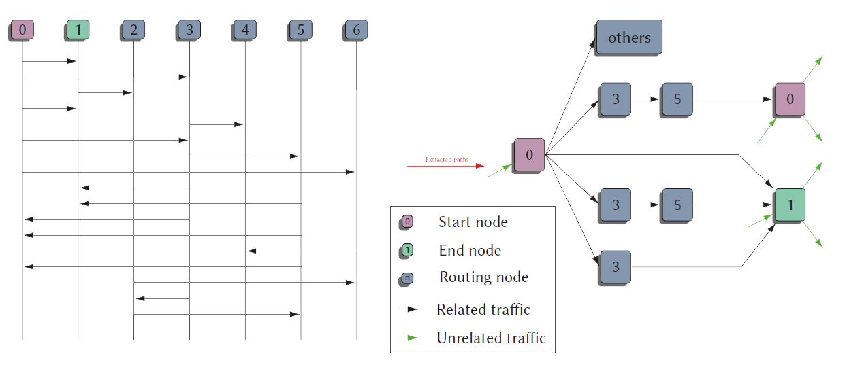
MessageVortex Analysis (5)

Slide 59
MessageVortex Analysis (5)
Major problem: There are no such things as common broadcasting protocols!
If a sender routes through an evil node, the evil node learns about IP/transport addresses accommodating of other nodes!

Slide 60
MessageVortex general weak spots of anonymization solutions
Identifiable sets for senders and receivers
Identifiable infrastructure
Nodes in general
Entry nodes
Exit nodes
Central elements in infrastructure
Directory servers
Not prone to active adversaries
Identifiable (censorable) protocols
(Limited) trust in infrastructure
Identifiable meta data
Identifiable messages
Replayable messages
Bugable parts
Tagable parts
Identification problem
Bootstrapping problem
Huge traffic overhead
Remains unsolved for censored environments
Notes:
Looking at the previous list of common problems for anonymity systems we can see, that we solved almost all common problems except for the bootstrapping problem and the huge traffic overhead.

Slide 61

Questions?
Notes:
Well that’s it…. Are there any questions left?

Slide 62
Addon SLides

Slide 63
MessageVortex Why do we need it?
Censorship: the cyclical suppression, banning, expurgation, or editing by an individual, institution, group or government that enforce or influence its decision against members of the public -- of any written or pictorial materials which that individual, institution, group or government deems obscene and ``utterly without redeeming social value,'' as determined by ``contemporary community standards.''
Chuck Stone
Professor at the School of Journalism and Mass Communication University of North Carolina
This definition includes self-censorship

Slide 64
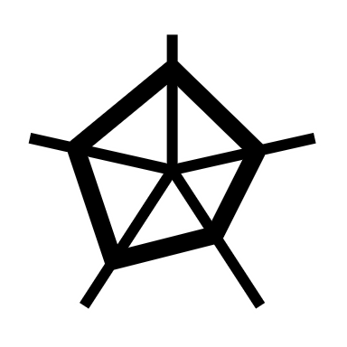

Technologies for Anonymity
Distribute data
DC-Nets
DHT
Some mix nets
Broadcast information
Typically only partial anonymity

Slide 65


Technologies for Censorship Circumvention
Hide data
Steganography
Mimicking of traffic (content and size wise)
Side channel transmission
Outcurve censorship measurements
Use modified TCP stacks
Use UDP

Slide 66
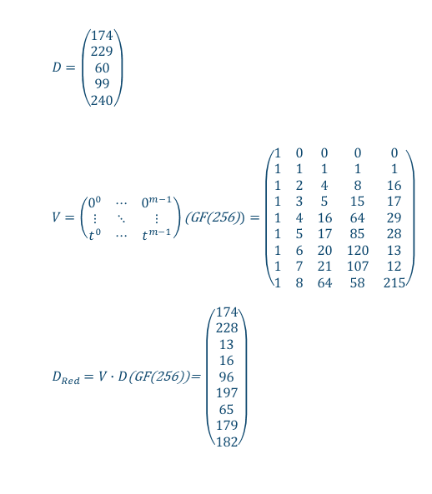
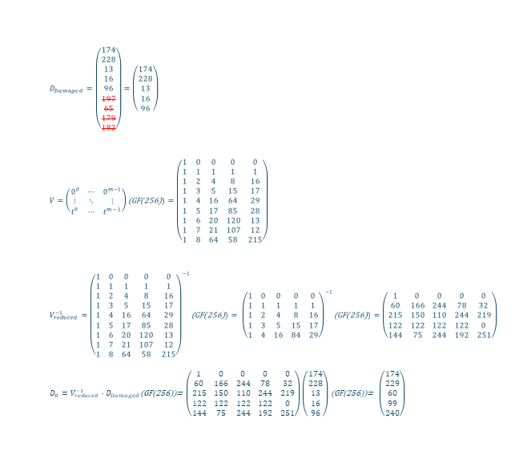
the RS-Operation
Adding redundancy information
Lo(u/s)sy transmission
Recovering data
$D_{Damaged}=\left(\begin{matrix}174 \\ 228 \\ 13 \\ 16 \\ 96 \\ 197 \\ 65 \\ 179 \\ 182\end{matrix}\right)=\left(\begin{matrix}174 \\ 228 \\ 13 \\ 16 \\ 96\end{matrix}\right)$
$V=\left(\begin{matrix}0^{0} & ⋯ & 0^{m−1} \\ ⋮ & ⋱ & ⋮ \\ t^{0} & ⋯ & t^{m−1}\end{matrix}\right)\text{(}\text{GF}\text{(256)})=\left(\begin{matrix}1 & 0 & 0 & 0 & 0 \\ 1 & 1 & 1 & 1 & 1 \\ 1 & 2 & 4 & 8 & 16 \\ 1 & 3 & 5 & 15 & 17 \\ 1 & 4 & 16 & 64 & 29 \\ 1 & 5 & 17 & 85 & 28 \\ 1 & 6 & 20 & 120 & 13 \\ 1 & 7 & 21 & 107 & 12 \\ 1 & 8 & 64 & 58 & 215\end{matrix}\right)$
$V_{reduced}^{−1}={\left(\begin{matrix}1 & 0 & 0 & 0 & 0 \\ 1 & 1 & 1 & 1 & 1 \\ 1 & 2 & 4 & 8 & 16 \\ 1 & 3 & 5 & 15 & 17 \\ 1 & 4 & 16 & 64 & 29 \\ 1 & 5 & 17 & 85 & 28 \\ 1 & 6 & 20 & 120 & 13 \\ 1 & 7 & 21 & 107 & 12 \\ 1 & 8 & 64 & 58 & 215\end{matrix}\right)}^{−1}\text{(}\text{GF}\text{(256)})= {\left(\begin{matrix}1 & 0 & 0 & 0 & 0 \\ 1 & 1 & 1 & 1 & 1 \\ 1 & 2 & 4 & 8 & 16 \\ 1 & 3 & 5 & 15 & 17 \\ 1 & 4 & 16 & 84 & 29\end{matrix}\right)}^{−1}\text{(}\text{GF}\text{(256)})=\left(\begin{matrix}1 & 0 & 0 & 0 & 0 \\ 60 & 166 & 244 & 78 & 32 \\ 215 & 150 & 110 & 244 & 219 \\ 122 & 122 & 122 & 122 & 0 \\ 144 & 75 & 244 & 192 & 251\end{matrix}\right)$
$D_{R}=V_{reduced}^{−1}∙D_{Damaged}$(GF(256))= $\left(\begin{matrix}1 & 0 & 0 & 0 & 0 \\ 60 & 166 & 244 & 78 & 32 \\ 215 & 150 & 110 & 244 & 219 \\ 122 & 122 & 122 & 122 & 0 \\ 144 & 75 & 244 & 192 & 251\end{matrix}\right)\left(\begin{matrix}174 \\ 228 \\ 13 \\ 16 \\ 96\end{matrix}\right)$ (GF(256))= $\left(\begin{matrix}174 \\ 229 \\ 60 \\ 99 \\ 240\end{matrix}\right)$
$D=\left(\begin{matrix}174 \\ 229 \\ 60 \\ 99 \\ 240\end{matrix}\right)$
$V=\left(\begin{matrix}0^{0} & ⋯ & 0^{m−1} \\ ⋮ & ⋱ & ⋮ \\ t^{0} & ⋯ & t^{m−1}\end{matrix}\right)\text{(}\text{GF}\text{(256)})=\left(\begin{matrix}1 & 0 & 0 & 0 & 0 \\ 1 & 1 & 1 & 1 & 1 \\ 1 & 2 & 4 & 8 & 16 \\ 1 & 3 & 5 & 15 & 17 \\ 1 & 4 & 16 & 64 & 29 \\ 1 & 5 & 17 & 85 & 28 \\ 1 & 6 & 20 & 120 & 13 \\ 1 & 7 & 21 & 107 & 12 \\ 1 & 8 & 64 & 58 & 215\end{matrix}\right)$
$D_{Red}=V∙D$(GF(256))= $\left(\begin{matrix}174 \\ 228 \\ 13 \\ 16 \\ 96 \\ 197 \\ 65 \\ 179 \\ 182\end{matrix}\right)$

Slide 67
GF-Log Table
omega=8
Add:xor; sub=xor;
mul=iif (c1 == 0 || c2 == 0;0; gfilog[gfLog[c1] + gfLog[c2]-iif(gfLog[c1] + gfLog[c2]>2^8-1;2^"+omega+"-1;0)]
div=iif (c1 == 0;0;iif(c2==0;illegal;gfilog[gfLog[c1] - gfLog[c2]+iif(gfLog[c1] - gfLog[c2]<>0;2^"+omega+"-1;0))]
| num | log |ilog | | num | log |ilog | | num | log |ilog | | num | log |ilog | | num | log |ilog | | num | log |ilog | | num | log |ilog | | num | log |ilog |
+-----+-----+-----+ +-----+-----+-----+ +-----+-----+-----+ +-----+-----+-----+ +-----+-----+-----+ +-----+-----+-----+ +-----+-----+-----+ +-----+-----+-----+
| 0 | -1 | 1 | | 32 | 5 | 157 | | 64 | 6 | 95 | | 96 | 30 | 217 | | 128 | 7 | 133 | | 160 | 55 | 230 | | 192 | 31 | 130 | | 224 | 203 | 18 |
| 1 | 0 | 2 | | 33 | 138 | 39 | | 65 | 191 | 190 | | 97 | 66 | 175 | | 129 | 112 | 23 | | 161 | 63 | 209 | | 193 | 45 | 25 | | 225 | 89 | 36 |
| 2 | 1 | 4 | | 34 | 101 | 78 | | 66 | 139 | 97 | | 98 | 182 | 67 | | 130 | 192 | 46 | | 162 | 209 | 191 | | 194 | 67 | 50 | | 226 | 95 | 72 |
| 3 | 25 | 8 | | 35 | 47 | 156 | | 67 | 98 | 194 | | 99 | 163 | 134 | | 131 | 247 | 92 | | 163 | 91 | 99 | | 195 | 216 | 100 | | 227 | 176 | 144 |
| 4 | 2 | 16 | | 36 | 225 | 37 | | 68 | 102 | 153 | | 100 | 195 | 17 | | 132 | 140 | 184 | | 164 | 149 | 198 | | 196 | 183 | 200 | | 228 | 156 | 61 |
| 5 | 50 | 32 | | 37 | 36 | 74 | | 69 | 221 | 47 | | 101 | 72 | 34 | | 133 | 128 | 109 | | 165 | 188 | 145 | | 197 | 123 | 141 | | 229 | 169 | 122 |
| 6 | 26 | 64 | | 38 | 15 | 148 | | 70 | 48 | 94 | | 102 | 126 | 68 | | 134 | 99 | 218 | | 166 | 207 | 63 | | 198 | 164 | 7 | | 230 | 160 | 244 |
| 7 | 198 | 128 | | 39 | 33 | 53 | | 71 | 253 | 188 | | 103 | 110 | 136 | | 135 | 13 | 169 | | 167 | 205 | 126 | | 199 | 118 | 14 | | 231 | 81 | 245 |
| 8 | 3 | 29 | | 40 | 53 | 106 | | 72 | 226 | 101 | | 104 | 107 | 13 | | 136 | 103 | 79 | | 168 | 144 | 252 | | 200 | 196 | 28 | | 232 | 11 | 247 |
| 9 | 223 | 58 | | 41 | 147 | 212 | | 73 | 152 | 202 | | 105 | 58 | 26 | | 137 | 74 | 158 | | 169 | 135 | 229 | | 201 | 23 | 56 | | 233 | 245 | 243 |
| 10 | 51 | 116 | | 42 | 142 | 181 | | 74 | 37 | 137 | | 106 | 40 | 52 | | 138 | 222 | 33 | | 170 | 151 | 215 | | 202 | 73 | 112 | | 234 | 22 | 251 |
| 11 | 238 | 232 | | 43 | 218 | 119 | | 75 | 179 | 15 | | 107 | 84 | 104 | | 139 | 237 | 66 | | 171 | 178 | 179 | | 203 | 236 | 224 | | 235 | 235 | 235 |
| 12 | 27 | 205 | | 44 | 240 | 238 | | 76 | 16 | 30 | | 108 | 250 | 208 | | 140 | 49 | 132 | | 172 | 220 | 123 | | 204 | 127 | 221 | | 236 | 122 | 203 |
| 13 | 104 | 135 | | 45 | 18 | 193 | | 77 | 145 | 60 | | 109 | 133 | 189 | | 141 | 197 | 21 | | 173 | 252 | 246 | | 205 | 12 | 167 | | 237 | 117 | 139 |
| 14 | 199 | 19 | | 46 | 130 | 159 | | 78 | 34 | 120 | | 110 | 186 | 103 | | 142 | 254 | 42 | | 174 | 190 | 241 | | 206 | 111 | 83 | | 238 | 44 | 11 |
| 15 | 75 | 38 | | 47 | 69 | 35 | | 79 | 136 | 240 | | 111 | 61 | 206 | | 143 | 24 | 84 | | 175 | 97 | 255 | | 207 | 246 | 166 | | 239 | 215 | 22 |
| 16 | 4 | 76 | | 48 | 29 | 70 | | 80 | 54 | 253 | | 112 | 202 | 129 | | 144 | 227 | 168 | | 176 | 242 | 227 | | 208 | 108 | 81 | | 240 | 79 | 44 |
| 17 | 100 | 152 | | 49 | 181 | 140 | | 81 | 208 | 231 | | 113 | 94 | 31 | | 145 | 165 | 77 | | 177 | 86 | 219 | | 209 | 161 | 162 | | 241 | 174 | 88 |
| 18 | 224 | 45 | | 50 | 194 | 5 | | 82 | 148 | 211 | | 114 | 155 | 62 | | 146 | 153 | 154 | | 178 | 211 | 171 | | 210 | 59 | 89 | | 242 | 213 | 176 |
| 19 | 14 | 90 | | 51 | 125 | 10 | | 83 | 206 | 187 | | 115 | 159 | 124 | | 147 | 119 | 41 | | 179 | 171 | 75 | | 211 | 82 | 178 | | 243 | 233 | 125 |
| 20 | 52 | 180 | | 52 | 106 | 20 | | 84 | 143 | 107 | | 116 | 10 | 248 | | 148 | 38 | 82 | | 180 | 20 | 150 | | 212 | 41 | 121 | | 244 | 230 | 250 |
| 21 | 141 | 117 | | 53 | 39 | 40 | | 85 | 150 | 214 | | 117 | 21 | 237 | | 149 | 184 | 164 | | 181 | 42 | 49 | | 213 | 157 | 242 | | 245 | 231 | 233 |
| 22 | 239 | 234 | | 54 | 249 | 80 | | 86 | 219 | 177 | | 118 | 121 | 199 | | 150 | 180 | 85 | | 182 | 93 | 98 | | 214 | 85 | 249 | | 246 | 173 | 207 |
| 23 | 129 | 201 | | 55 | 185 | 160 | | 87 | 189 | 127 | | 119 | 43 | 147 | | 151 | 124 | 170 | | 183 | 158 | 196 | | 215 | 170 | 239 | | 247 | 232 | 131 |
| 24 | 28 | 143 | | 56 | 201 | 93 | | 88 | 241 | 254 | | 120 | 78 | 59 | | 152 | 17 | 73 | | 184 | 132 | 149 | | 216 | 251 | 195 | | 248 | 116 | 27 |
| 25 | 193 | 3 | | 57 | 154 | 186 | | 89 | 210 | 225 | | 121 | 212 | 118 | | 153 | 68 | 146 | | 185 | 60 | 55 | | 217 | 96 | 155 | | 249 | 214 | 54 |
| 26 | 105 | 6 | | 58 | 9 | 105 | | 90 | 19 | 223 | | 122 | 229 | 236 | | 154 | 146 | 57 | | 186 | 57 | 110 | | 218 | 134 | 43 | | 250 | 244 | 108 |
| 27 | 248 | 12 | | 59 | 120 | 210 | | 91 | 92 | 163 | | 123 | 172 | 197 | | 155 | 217 | 114 | | 187 | 83 | 220 | | 219 | 177 | 86 | | 251 | 234 | 216 |
| 28 | 200 | 24 | | 60 | 77 | 185 | | 92 | 131 | 91 | | 124 | 115 | 151 | | 156 | 35 | 228 | | 188 | 71 | 165 | | 220 | 187 | 172 | | 252 | 168 | 173 |
| 29 | 8 | 48 | | 61 | 228 | 111 | | 93 | 56 | 182 | | 125 | 243 | 51 | | 157 | 32 | 213 | | 189 | 109 | 87 | | 221 | 204 | 69 | | 253 | 80 | 71 |
| 30 | 76 | 96 | | 62 | 114 | 222 | | 94 | 70 | 113 | | 126 | 167 | 102 | | 158 | 137 | 183 | | 190 | 65 | 174 | | 222 | 62 | 138 | | 254 | 88 | 142 |
| 31 | 113 | 192 | | 63 | 166 | 161 | | 95 | 64 | 226 | | 127 | 87 | 204 | | 159 | 46 | 115 | | 191 | 162 | 65 | | 223 | 90 | 9 | | 255 | 175 | -1 |

Slide 68
MessageVortex Routing Strategies (specific)
Sending a message part
Split and encrypt
Join and encrypt
Encrypt only (may be decrypt only as well; Use with caution)
addRedundancy
May include additional split or join
NO reocurrence of data
No forwarding of data without at least one encryption step involved
No reverse operations anywhere on untrusted nodes
Creating decoy traffic
Use addRedundancy to add decoy
Same restrictions apply as if sending a message part
Removing decoy traffic
Do not do anything with a payload block
For the node this looks as:
Decoy
Redundant traffic not picked up
Diagnosis traffic not handled
Malfunctioning path
Sending received decoy traffic
Same as sending a message part

Slide 69
MessageVortex Processing an outgoing message
Triggered by the timing information in the routing combo
Assemble the payload blocks by applying the operations provided. If done execute the mapping to the IDs 1-127
Add routing block, prefix blocks (containing the sender and peer keys), and the header block to the message (all blocks are provided as preencrypted binary blobs)
Encrypt inner message
Apply blending according to spec in the routing combo.
Send message by using the transport layer.

Slide 70
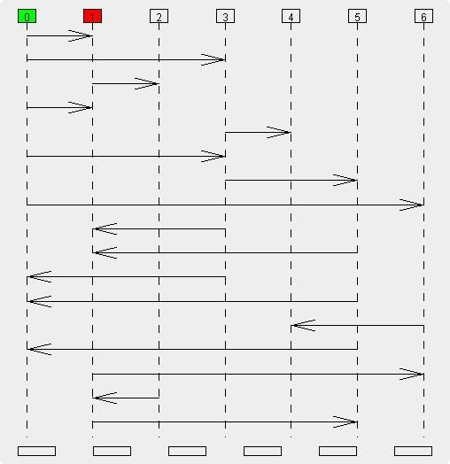
MessageVortex Reduced example graph
VortexNode 3
VortexNode 1
VortexNode 3
VortexNode 5
VortexNode 0
VortexNode 0
VortexNode 3
VortexNode 5
VortexNode Others

Slide 71
MessageVortex routing diagnosis
Possible by routing parts of the message back to the originator.
As all operations are known the resulting payload blocks are foreseeable.
If traffic is illicit, additional messages picking up more parts from other workspaces may be injected to narrow down diagnosis of misbehaving nodes
Successful message delivery may be tracked by routing parts of the message from the recipients node back to the sender (directly or indirectly).

Slide 72
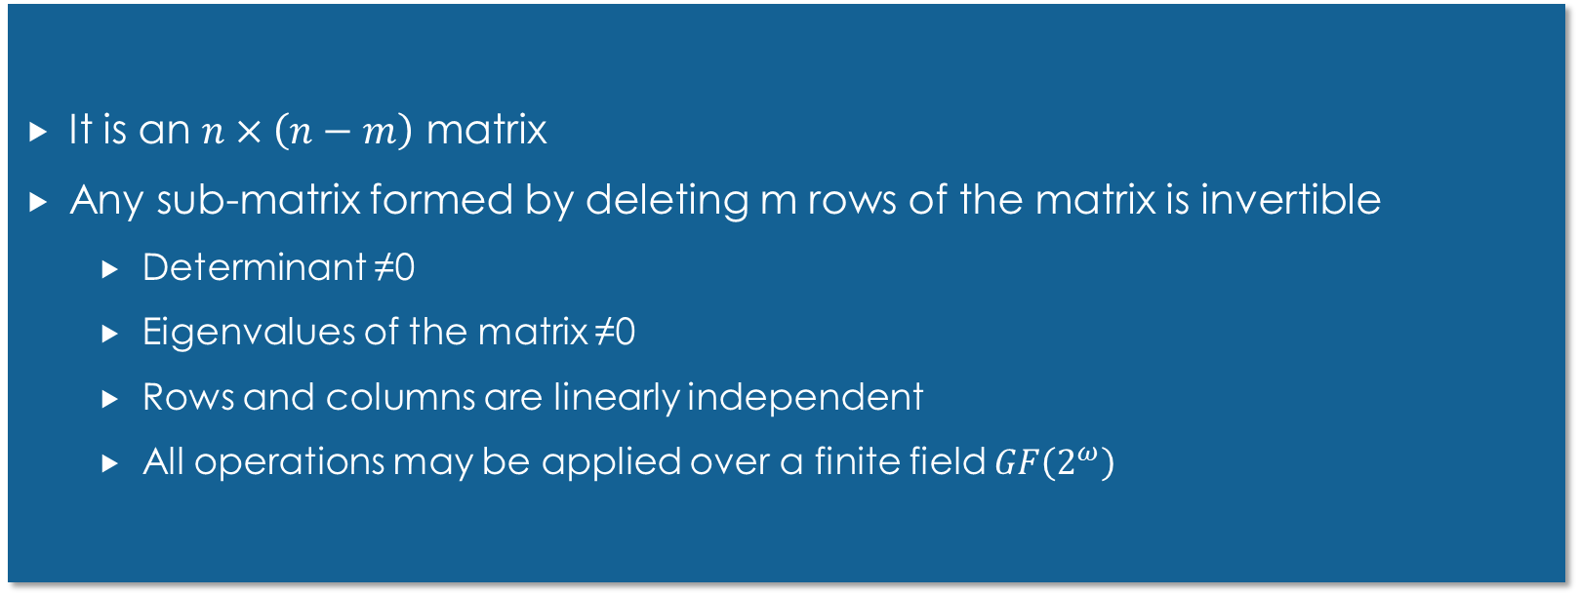
Properties for the Dispersal Matrix
It is an $n×\left(n−m\right)$ matrix
Any sub-matrix formed by deleting m rows of the matrix is invertible
Determinant ≠0
Eigenvalues of the matrix ≠0
Rows and columns are linearly independent
All operations may be applied over a finite field $GF\left(2^{ω}\right)$

Slide 73
Comparing MessageVortex MV (Mimicking) compared to a type-0 remailer
MessageVortex
+ Steganogragphically secured transport
+ Protocol agnostic
+ Unknown sending and receiving nodes
Only MV as endpoints
Higher complexity
Higher transport overhead
Type-0 Remailer
+ Simple implementation
Easily observable (no encryption and identical, observable content)
Requires internet infrastructure
Common
Anonymity breakable by remailer

Slide 74
Comparing MessageVortex MV (Mimicking) compared to a type-0 remailer (Nym)
MessageVortex
+ Steganogragphically secured transport
+ Protocol agnostic
+ unknown sending and receiving nodes
Higher complexity
Higher transport overhead
Type-0 Remailer
+ Simple implementation
+ No dedicated Transport protocol
Easily observable
Requires internet infrastructure
Common
+ No dedicated transport protocol
Anonymity breakable by router

Slide 75
Comparing MessageVortex MV (Mimicking) compared to a type-1 remailer (Cypherpunk)
MessageVortex
+ Steganogragphically secured transport
+ Protocol agnostic
+ unknown sending and receiving nodes
Only MV as endpoints
Higher complexity
Higher transport overhead
Type-1 Remailer
+ Simple implementation
+ No dedicated Transport protocol
+ Recipient may be any Email-Address
Easily observable
Requires internet infrastructure
Common
+ No dedicated anonymity protocol
Anonymity breakable by router

Slide 76
Comparing MessageVortex MV (Mimicking) compared to a type-2 remailer (Mixmaster)
MessageVortex
+ Steganogragphically secured transport
+ Protocol agnostic
+ Unobservable message size
+ unknown sending and receiving nodes
Higher complexity
Higher transport overhead
Type-2 Remailer
+ Simple implementation
+ Constant message size
+ No dedicated Transport protocol
Dedicated protocol
Requires internet infrastructure
Messages identifiable as PGP encrypted
Common
+ Multiple message paths possible for chunks

Slide 77
Comparing MessageVortex MV (Mimicking) compared to a type-3 remailer (Mixmaster)
MessageVortex
+ Steganogragphically secured transport
+ Protocol agnostic
+ Unobservable message size
+unknown sending and receiving nodes
Higher complexity
Higher transport overhead
Type-3 Remailer
+ Simple implementation
+ Constant message size
Dedicated protocol
Requires internet infrastructure
Common
+ Multiple message paths possible for chunks

Slide 78
Comparing MessageVortex MV compared to a DC-Network
MessageVortex
+ Steganogragphically secured transport
+ Protocol agnostic
+ Unobservable message size
Possibly higher transport overhead
DC-Network
+ Provable security
Dedicated protocol
Requires internet infrastructure
Complex two way communication pattern (identifiable and pretty unique)
Message sizes/transfer volumes are typically known
Hard to secure against active adversaries
Requires typically an ideal broadcast

Slide 79
MessageVortex Block Header block
HeaderBlock ::= SEQUENCE {
-- Public key of the identity representing this
-- transmission
identityKey AsymmetricKey,
-- serial identifying this block
serial INTEGER (0..maxSerial),
-- number of times this block may be replayed
-- (Tuple is identityKey, serial while UsagePeriod
-- of block)
maxReplays INTEGER (0..maxNumberOfReplays),
-- subsequent Blocks are not processed before
-- valid time.
-- Host may reject too long retention. Recomended
-- validity support >=1Mt.
valid UsagePeriod,
-- represents the chained secret which has to be
-- found in subsequent blocks prevents reassembly
-- attack
forwardSecret ChainSecret,
-- contains the MAC-Algorithm used for signing
signAlgorithm MacAlgorithmSpec,
-- contains administrative requests such as quota
-- requests
requests SEQUENCE
(SIZE (0..maxNumberOfRequests))
OF HeaderRequest ,
-- Reply Block for the requests
requestReplyBlock RoutingCombo,
-- padding and identitifier required to solve the
-- cryptopuzzle
identifier [12201] PuzzleIdentifier OPTIONAL,
-- This is for solving crypto puzzles
proofOfWork [12202] OCTET STRING OPTIONAL
}

Slide 80
MessageVortex Block Routing Block
RoutingBlock ::= SEQUENCE {
-- contains the routingCombos
routing [331] SEQUENCE (SIZE (0..maxRoutingBlocks))
OF RoutingCombo,
-- contains the secret of the header block
forwardSecret ChainSecret,
-- contains the mapping operations to map payloads
-- to the workspace
mappings [332] SEQUENCE
(SIZE (0..maxPayloadBlocks))
OF MapBlockOperation,
-- contains a routing block which may be used when
-- sending error messages back to the quota owner
-- this routing block may be cached for future use
replyBlock [332] SEQUENCE {
murb RoutingCombo,
maxReplay INTEGER,
validity UsagePeriod
} OPTIONAL
}
RoutingCombo ::= SEQUENCE {
-- contains the period when the payload should be
-- processed.
-- Router might refuse too long queue retention
-- Recommended support for retention >=1h
minProcessTime INTEGER (0..maxDurationOfProcessing),
maxProcessTime INTEGER (0..maxDurationOfProcessing),
-- The message key to encrypt the message
peerKey [401] SEQUENCE (1..maxNumberOfReplays)
SymmetricKey OPTIONAL,
-- contains the next recipient
recipient [402] BlendingSpec,
-- PrefixBlock encrypted with message key
mPrefix [403] SEQUENCE (1..maxNumberOfReplays)
OF OCTET STRING OPTIONAL,
-- PrefixBlock encrypted with sender key
cPrefix [404] OCTET STRING OPTIONAL,
-- HeaderBlock encrypted with sender key
header [405] OCTET STRING OPTIONAL,
-- RoutingBlock encrypted with sender key
routing [406] OCTET STRING OPTIONAL,
-- contains information for building messages (when
-- used as MURB)
-- ID 0 denotes original/local message
-- ID 1-maxPayloadBlocks denotes target message
-- 32768-maxWorkspaceId shared workspace for all
-- blocks of this identity)
assembly [407] SEQUENCE
(SIZE (0..maxAssemblyInstructions))
OF PayloadOperation,
-- optional for storage of the arrival time
validity [408] UsagePeriod OPTIONAL,
}

